Slide 1
Battle of the Neighborhoods
Presented by:
Murat Dibi

Slide 2
Content
Business Problem Description
Overview of the Data
Methodology
Analysis
Results and Discussion
Conclusion

Slide 3
Business Problem Description
The City of New York, is the most crowded and popular US. It is a harmony of cultures and cousins. Opening a new business can be a good opportunity in New York. However it is also risky because of the competitive market and high operating costs. . Selecting the right place for the business is going to be helpful to increase chances of being successful.
An investor wants to open a new business in Manhattan, the budget for this business is limited. This business will focus on restaurant supplies and food for Mediterranean restaurants. I will help my client to analyze the provided data and help him to find the best place for this business. Planning before investment will be crucial. This place should be close to most of the target restaurants.

Slide 4
Data
To analyze neigborhoods:
Neighborhoods of New York Dataset
https://geo.nyu.edu/catalog/nyu_2451_34572
To analyze venue categories and their locations:
Foursquare developer portal
Venues Categories - https://developer.foursquare.com/docs/resources/categories
Mediterranean Restaurant id:4bf58dd8d48988d1c0941735

Slide 5
Methodology
Neighborhoods of Manhattan
Foursquare developer API used for venues in the neighborhoods.
Filtering neighborhoods.
Clustering (k-means clustering) was used to find the clusters of similar neighborhoods.

Slide 6
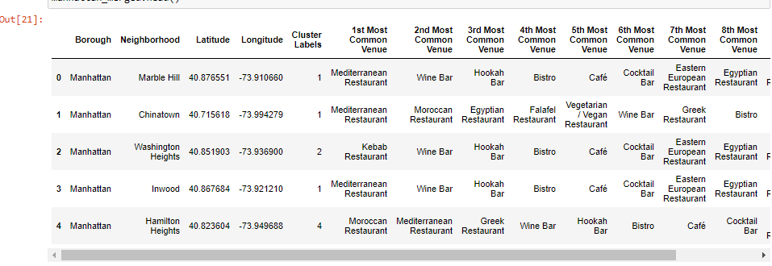
Clusters Table

Slide 7
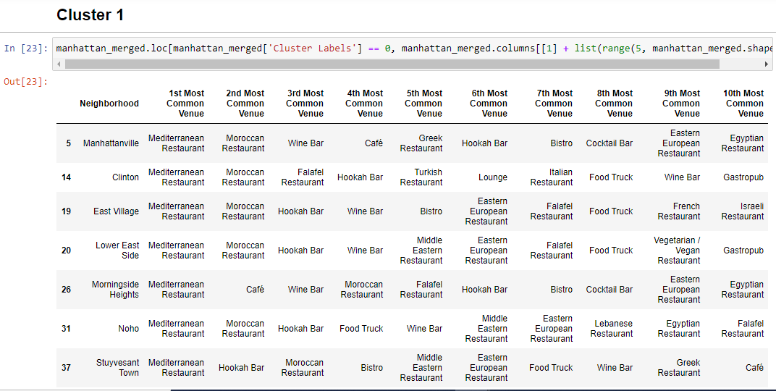

Slide 8
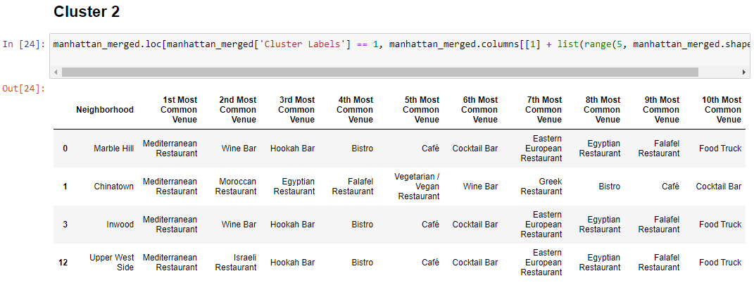

Slide 9
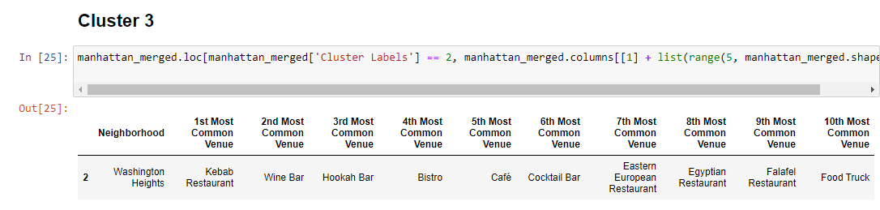

Slide 10
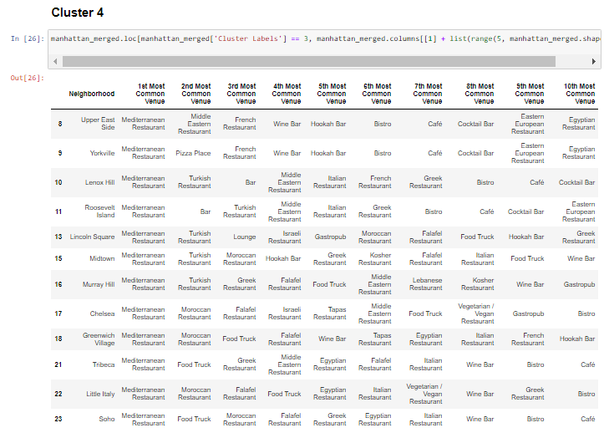

Slide 11
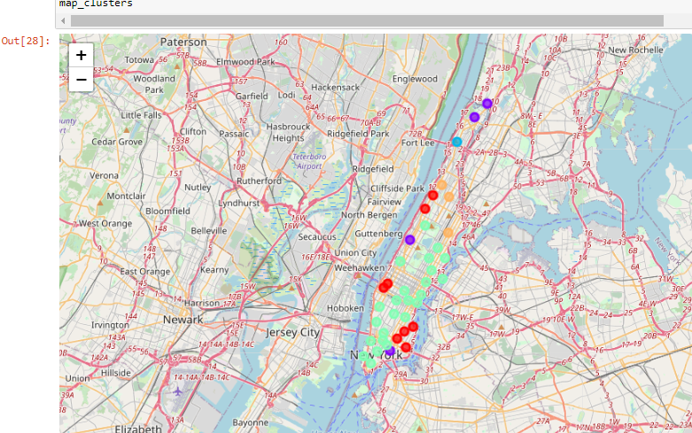
Clusters on the map

Slide 12

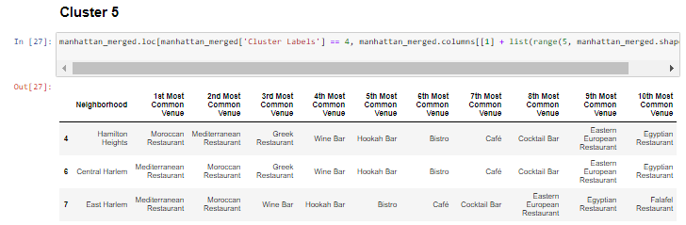

Slide 13
Results and Discussion
5 clusters found.
Potential clusters suitable for the business are Cluster 4 and Cluster 1.

Slide 14
Conclusion
There are many clusters with the target restaurants, among these clusters locating the business in the area of cluster4 will be more reasonable..

